Slide 1



SPOTIFY
Music Selector
PTDS 2022 Final Project
Group A
Gigandet Yooby
Huang Jiaming
Yang Ting

Slide 2
Goals
Provide users’ favorite music list based on their selection
Obtain a list based on two different algorithms
Plans
Allow users to choose preferable music feature and its levels to fine-tune the music recommendations
Calculate the gap between songs and the users’ selection. Give weight to score to obtain the matched list
Compute cosine similarity to obtain the matched list

Slide 3
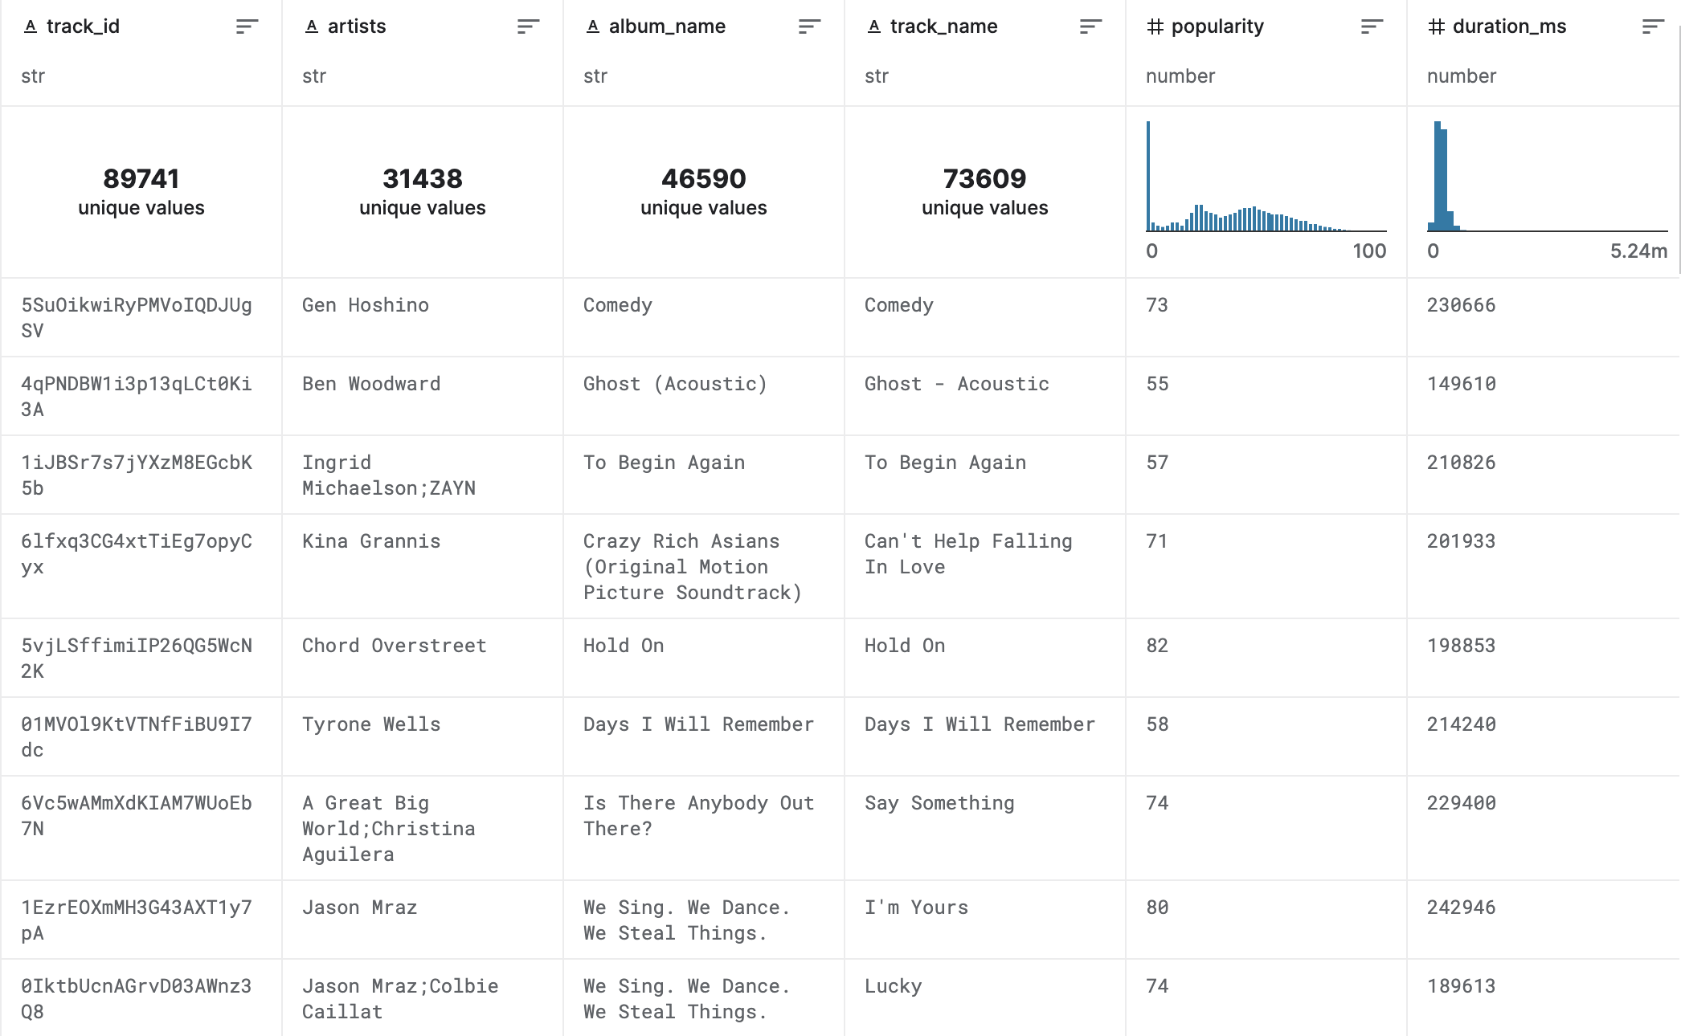
Data Preparation
Data Source
CSV file from Kaggle
106,943 observations (songs)
20 column
16 features & corresponding levels
Clean Data
Unifiedly Scale features’ level to be from 1 to 10
Encoding
Clean duplicated rows

Slide 4

ALGORITHMS

Slide 5

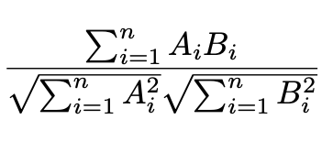
Simple Scoring
Calculate the gap between each song and the users’ choice. Assign weights to each score in order, calculate the average score of each song, and select the ten songs with the largest scores as the recommended song list
Cosine similarity
N = feature
Score_n = 10 - ( abs ( selected level – song’s level)
Final score = (0.5*score_1 + 0.2*score_2 + 0.15*score_3 + 0.01*score_4 + 0.05*score_5)
Create similarity scores for songs by calculating the cosine similarity between the selected filters and other songs in the database to recommend the songs which have the largest similarity with the filters.

Slide 6
R PACKAGE

Slide 7
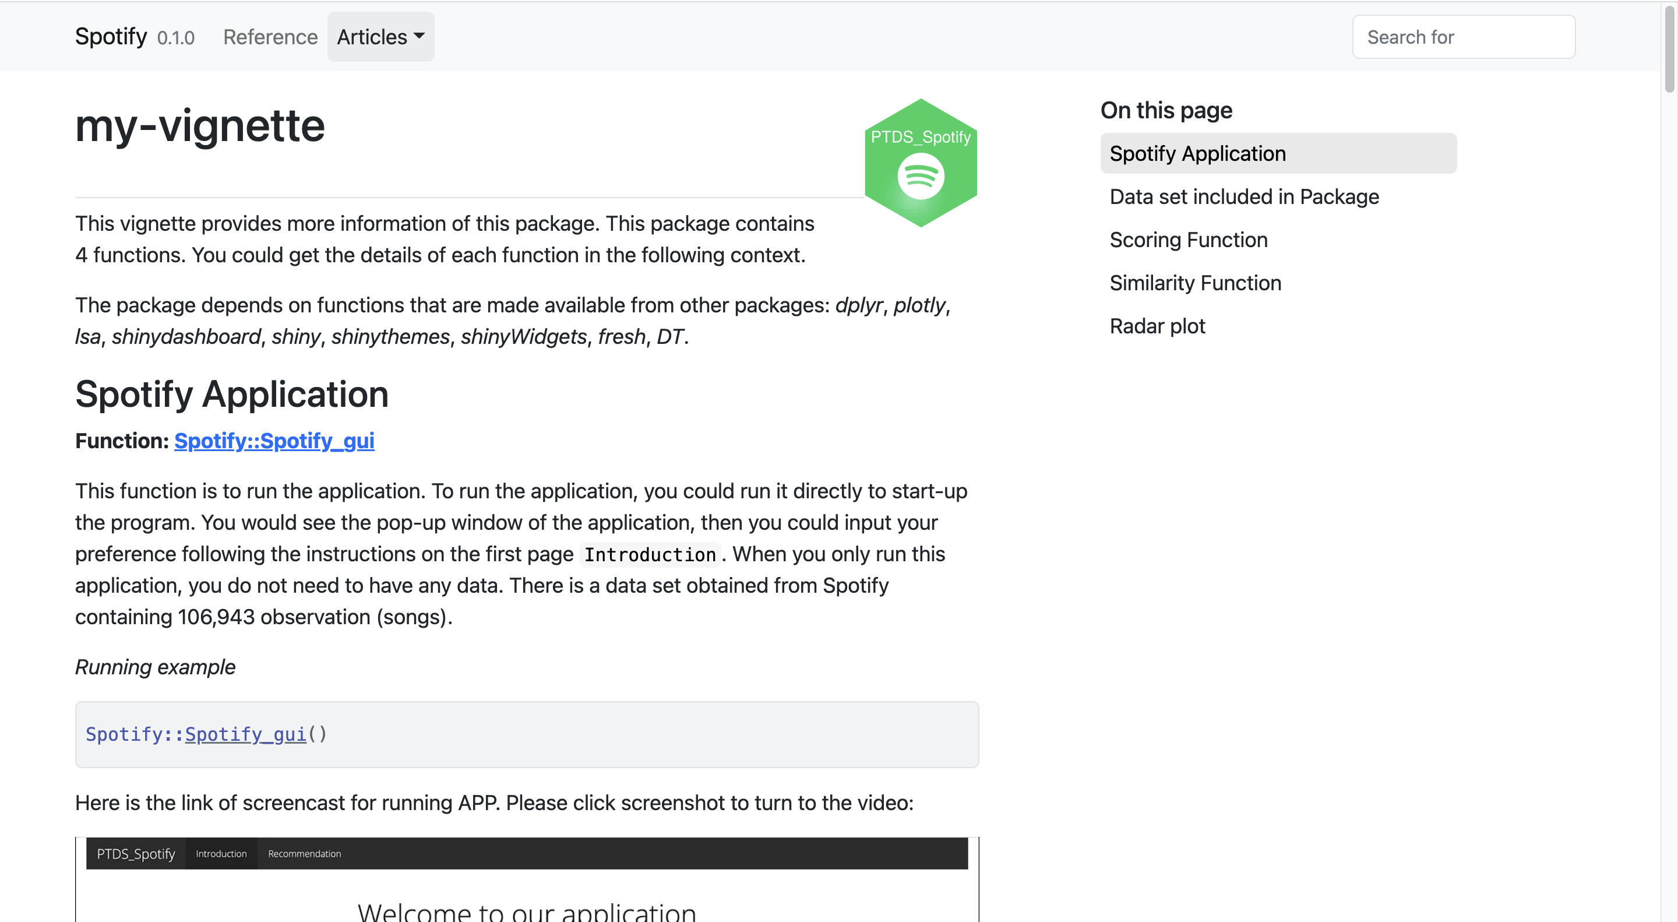
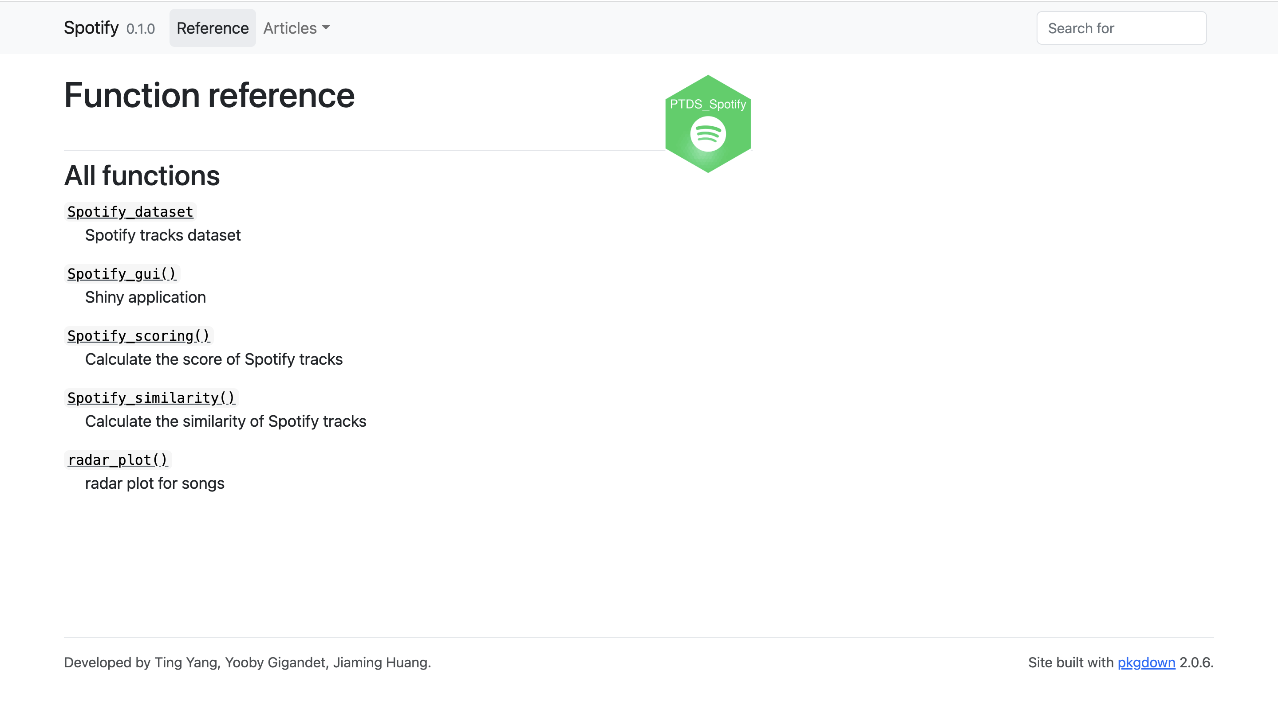
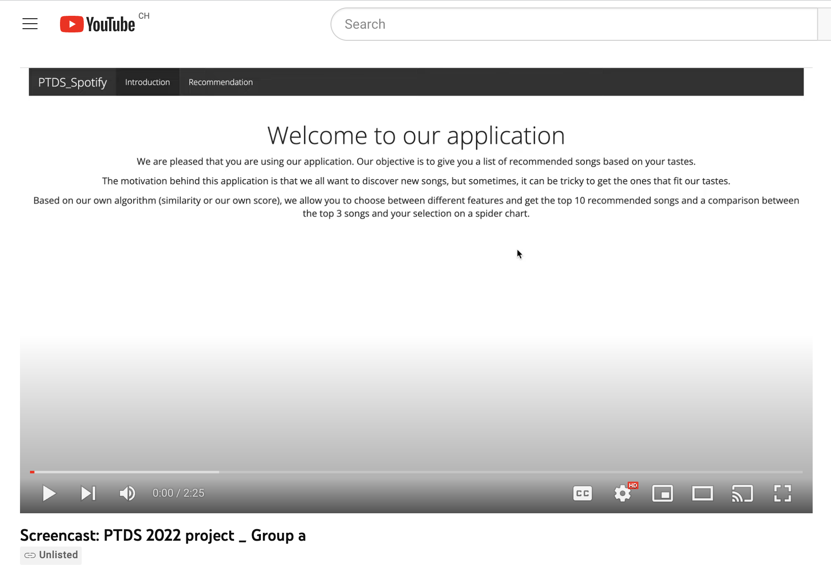
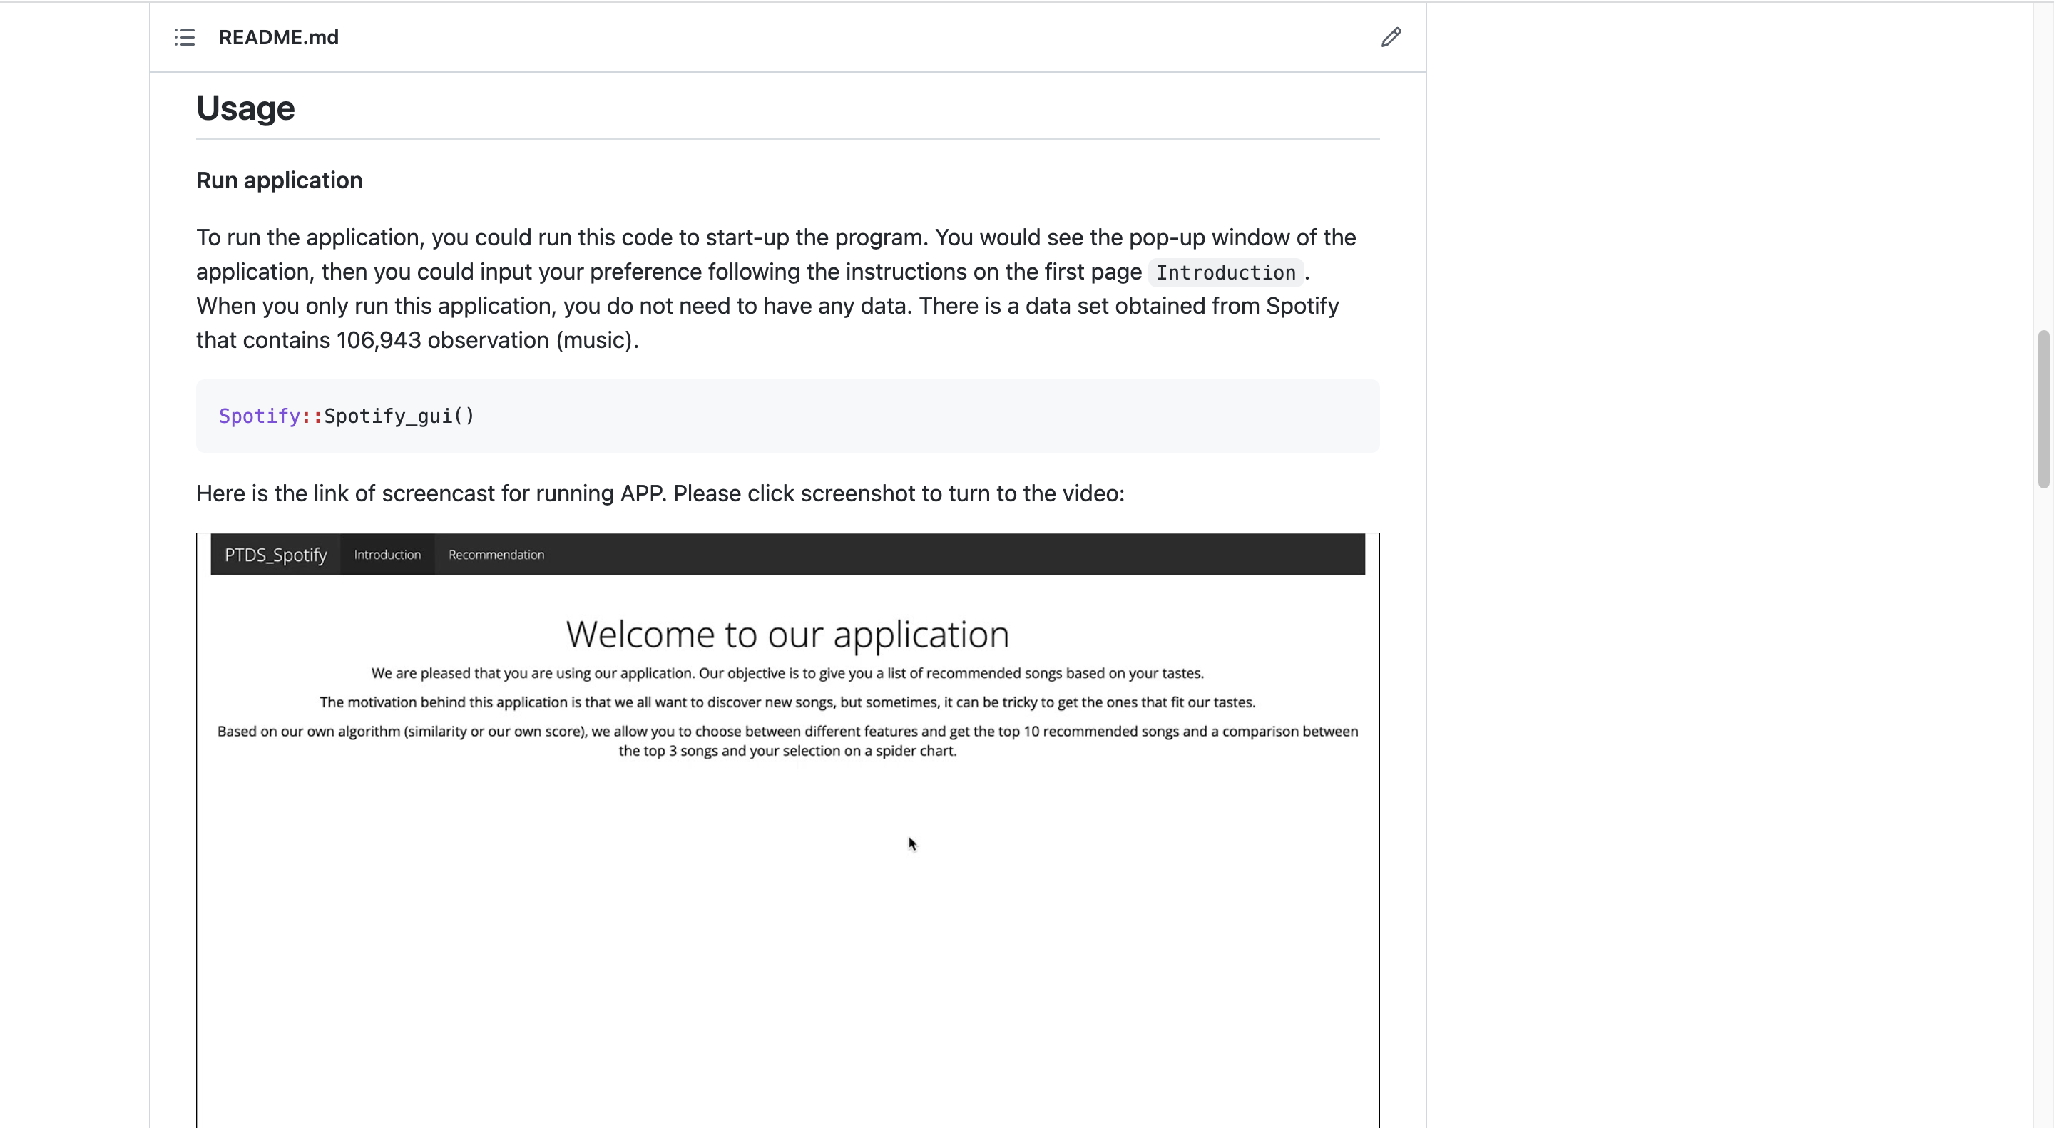
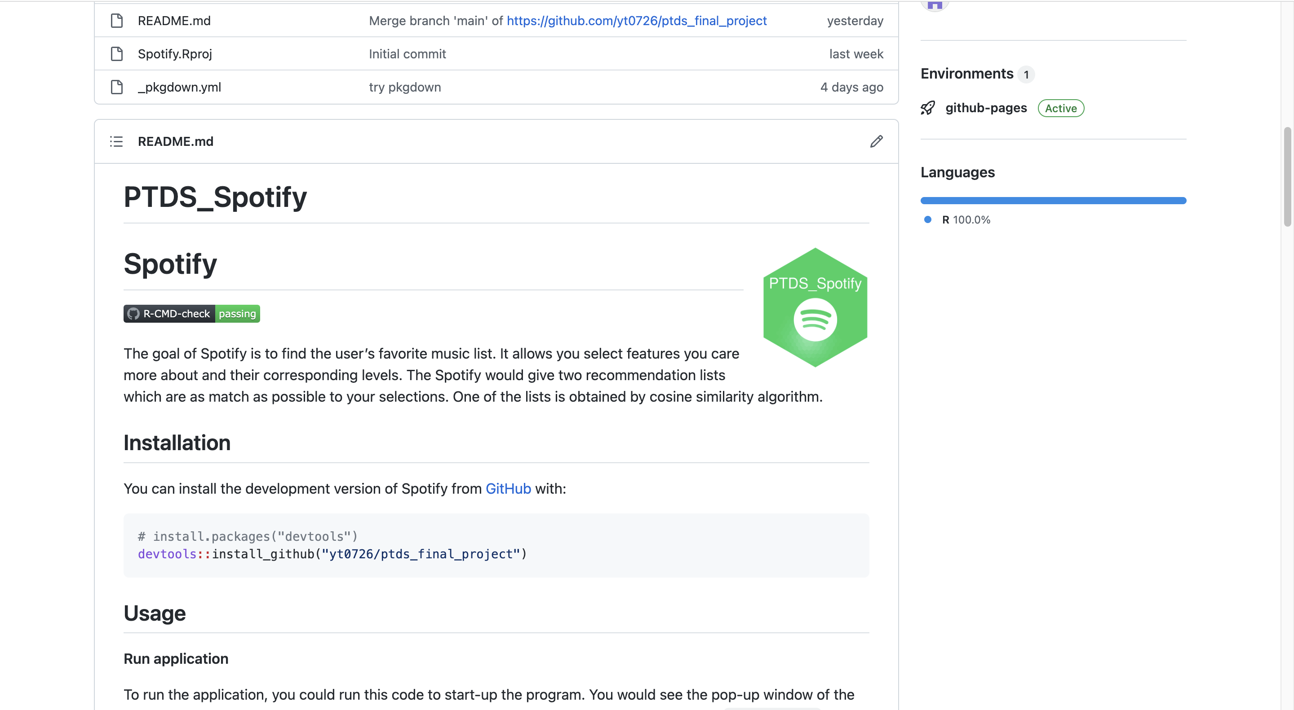
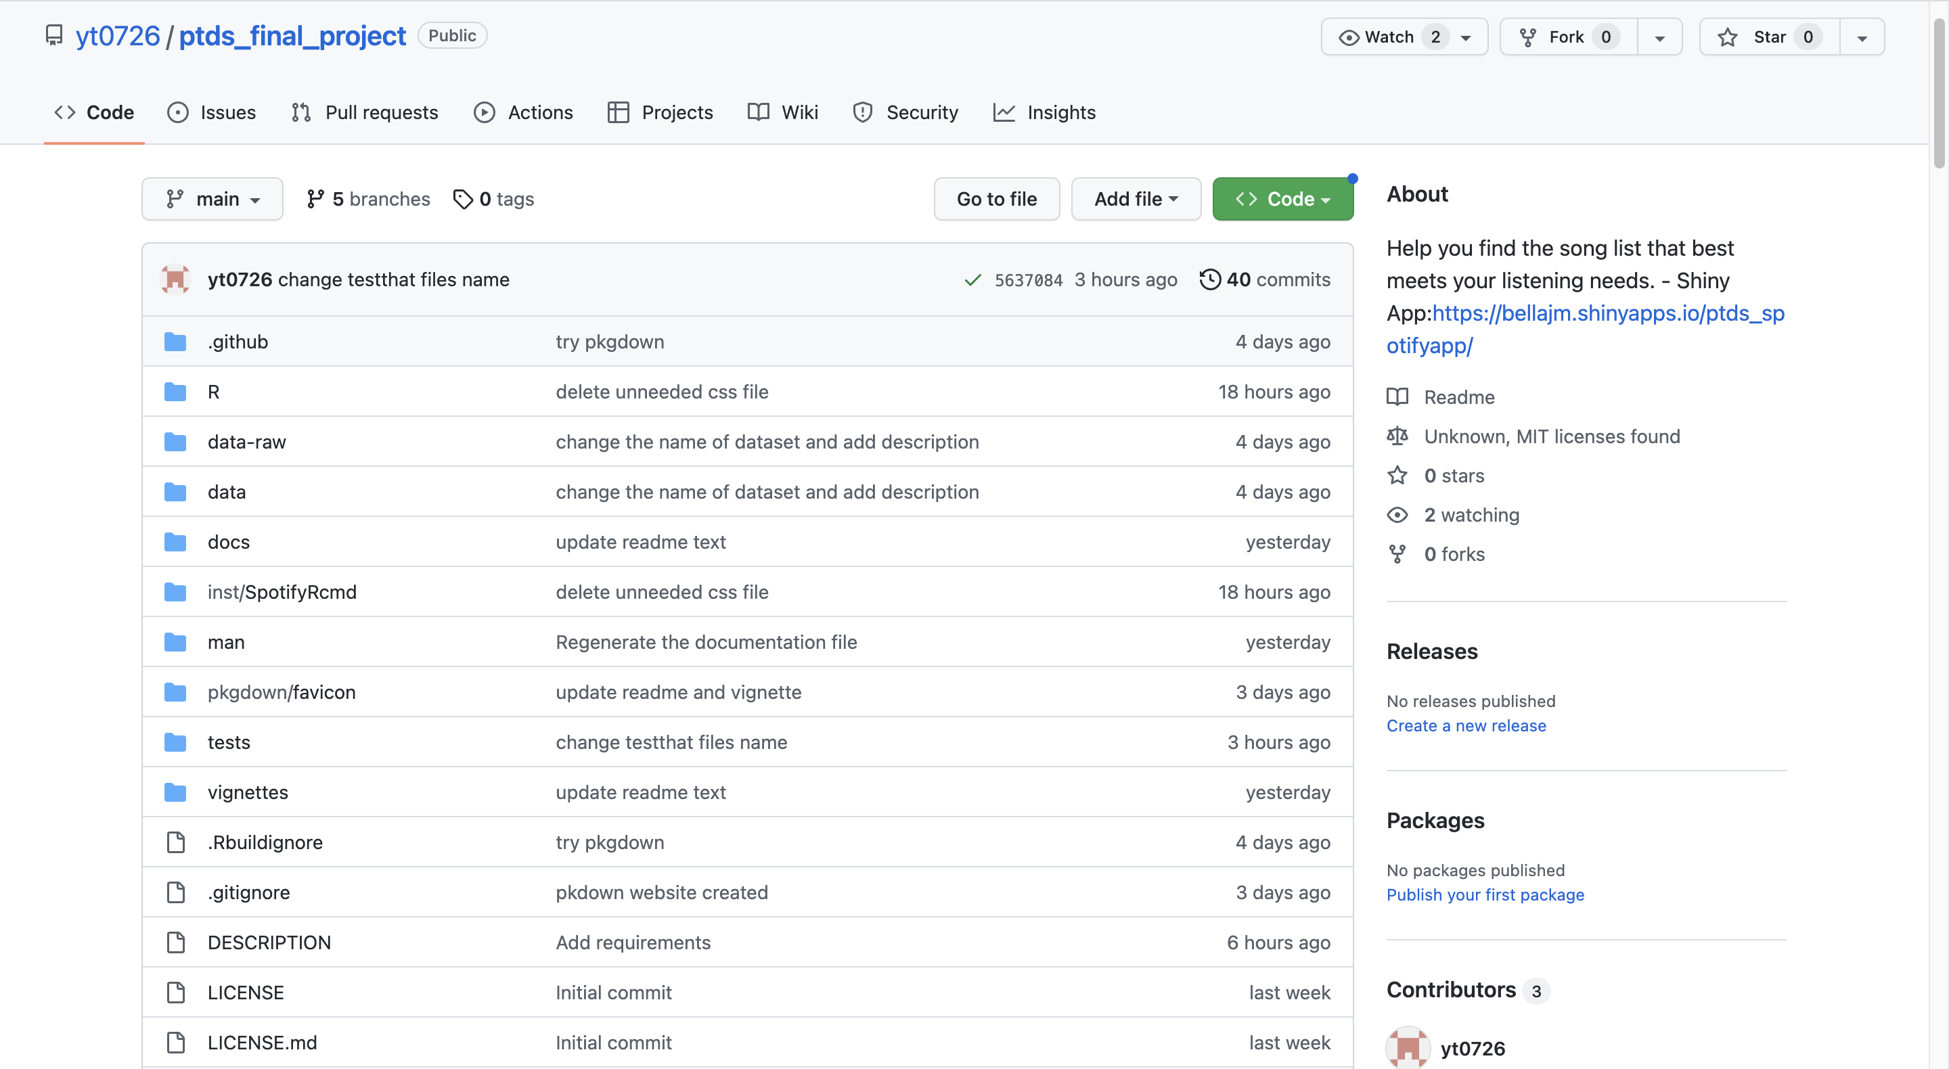
R Package in GitHub
Package Source
ptds2022/final-project-group-a-1
yt0726/ptds_final_project

Slide 8
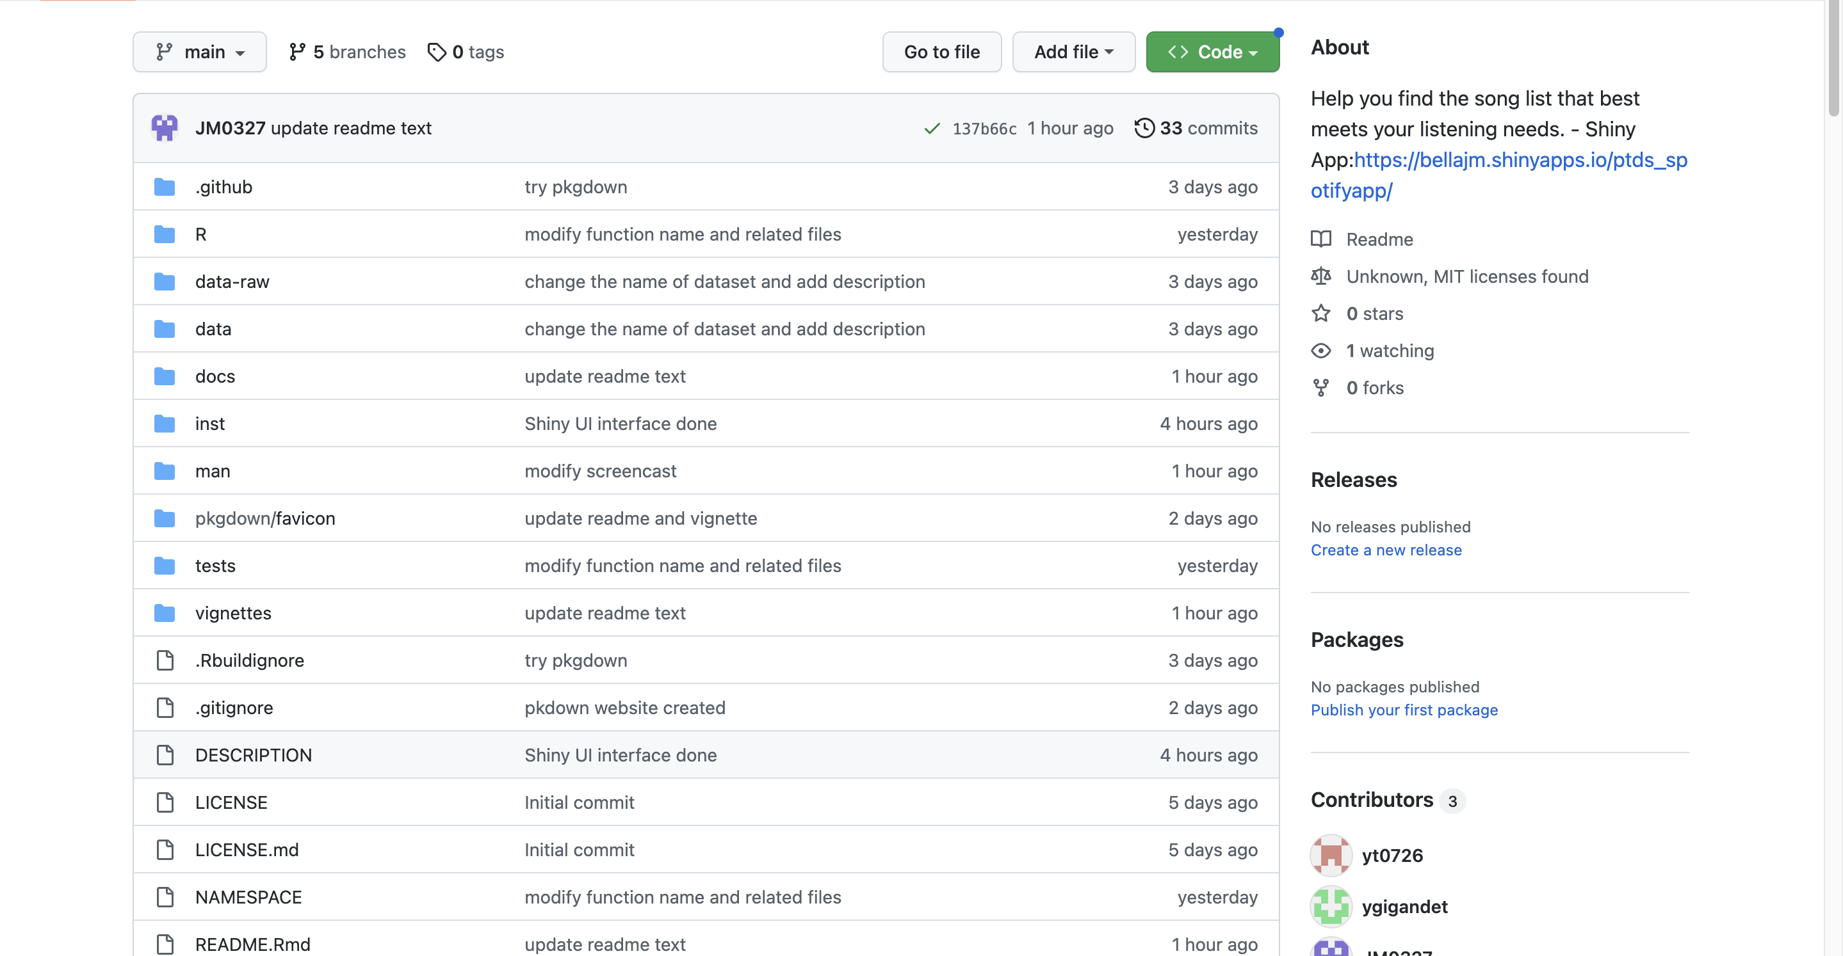
R Package in GitHub
Application
Find the link to the application website over the About session

Slide 9
R Package in GitHub
Readme
Brief introduction of the package and the application

Slide 10
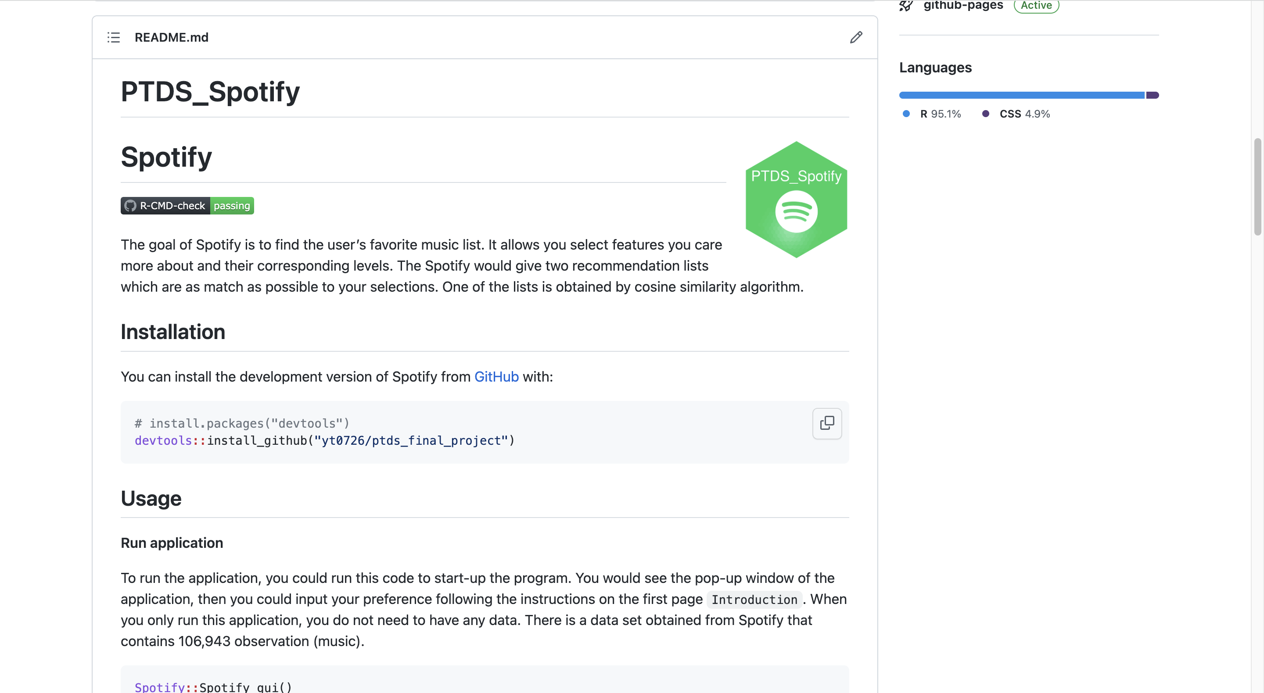
R Package in GitHub
Readme
Find Package install commend

Slide 11
R Package in GitHub
Readme
Screencast for introducing the application manipulation

Slide 12
R Package in GitHub
Readme
Click YouTube's preview picture
Turn to the introduction screencast

Slide 13
R Package in GitHub
Readme
Click github - pages

Slide 14
R Package in GitHub
Website
Find documentation for each function

Slide 15
R Package in GitHub
Website
Find my-vignette

Slide 16
SHINY APP

Slide 17

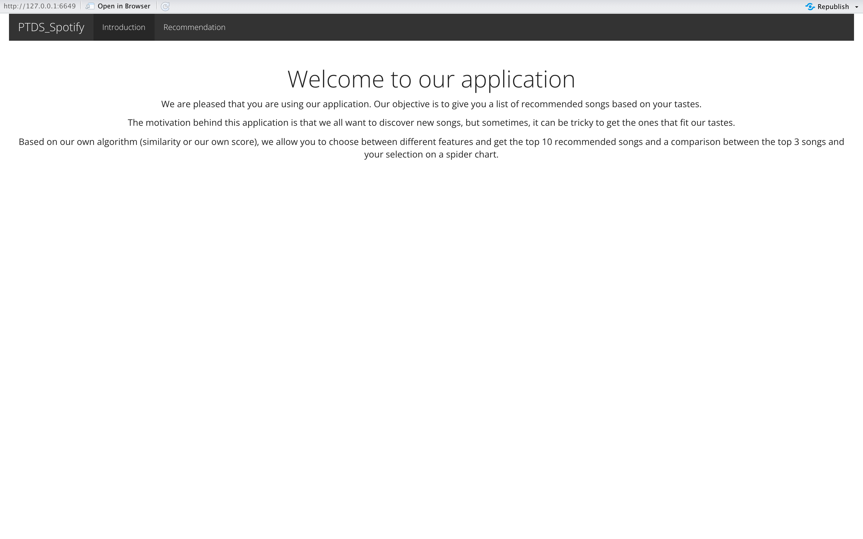
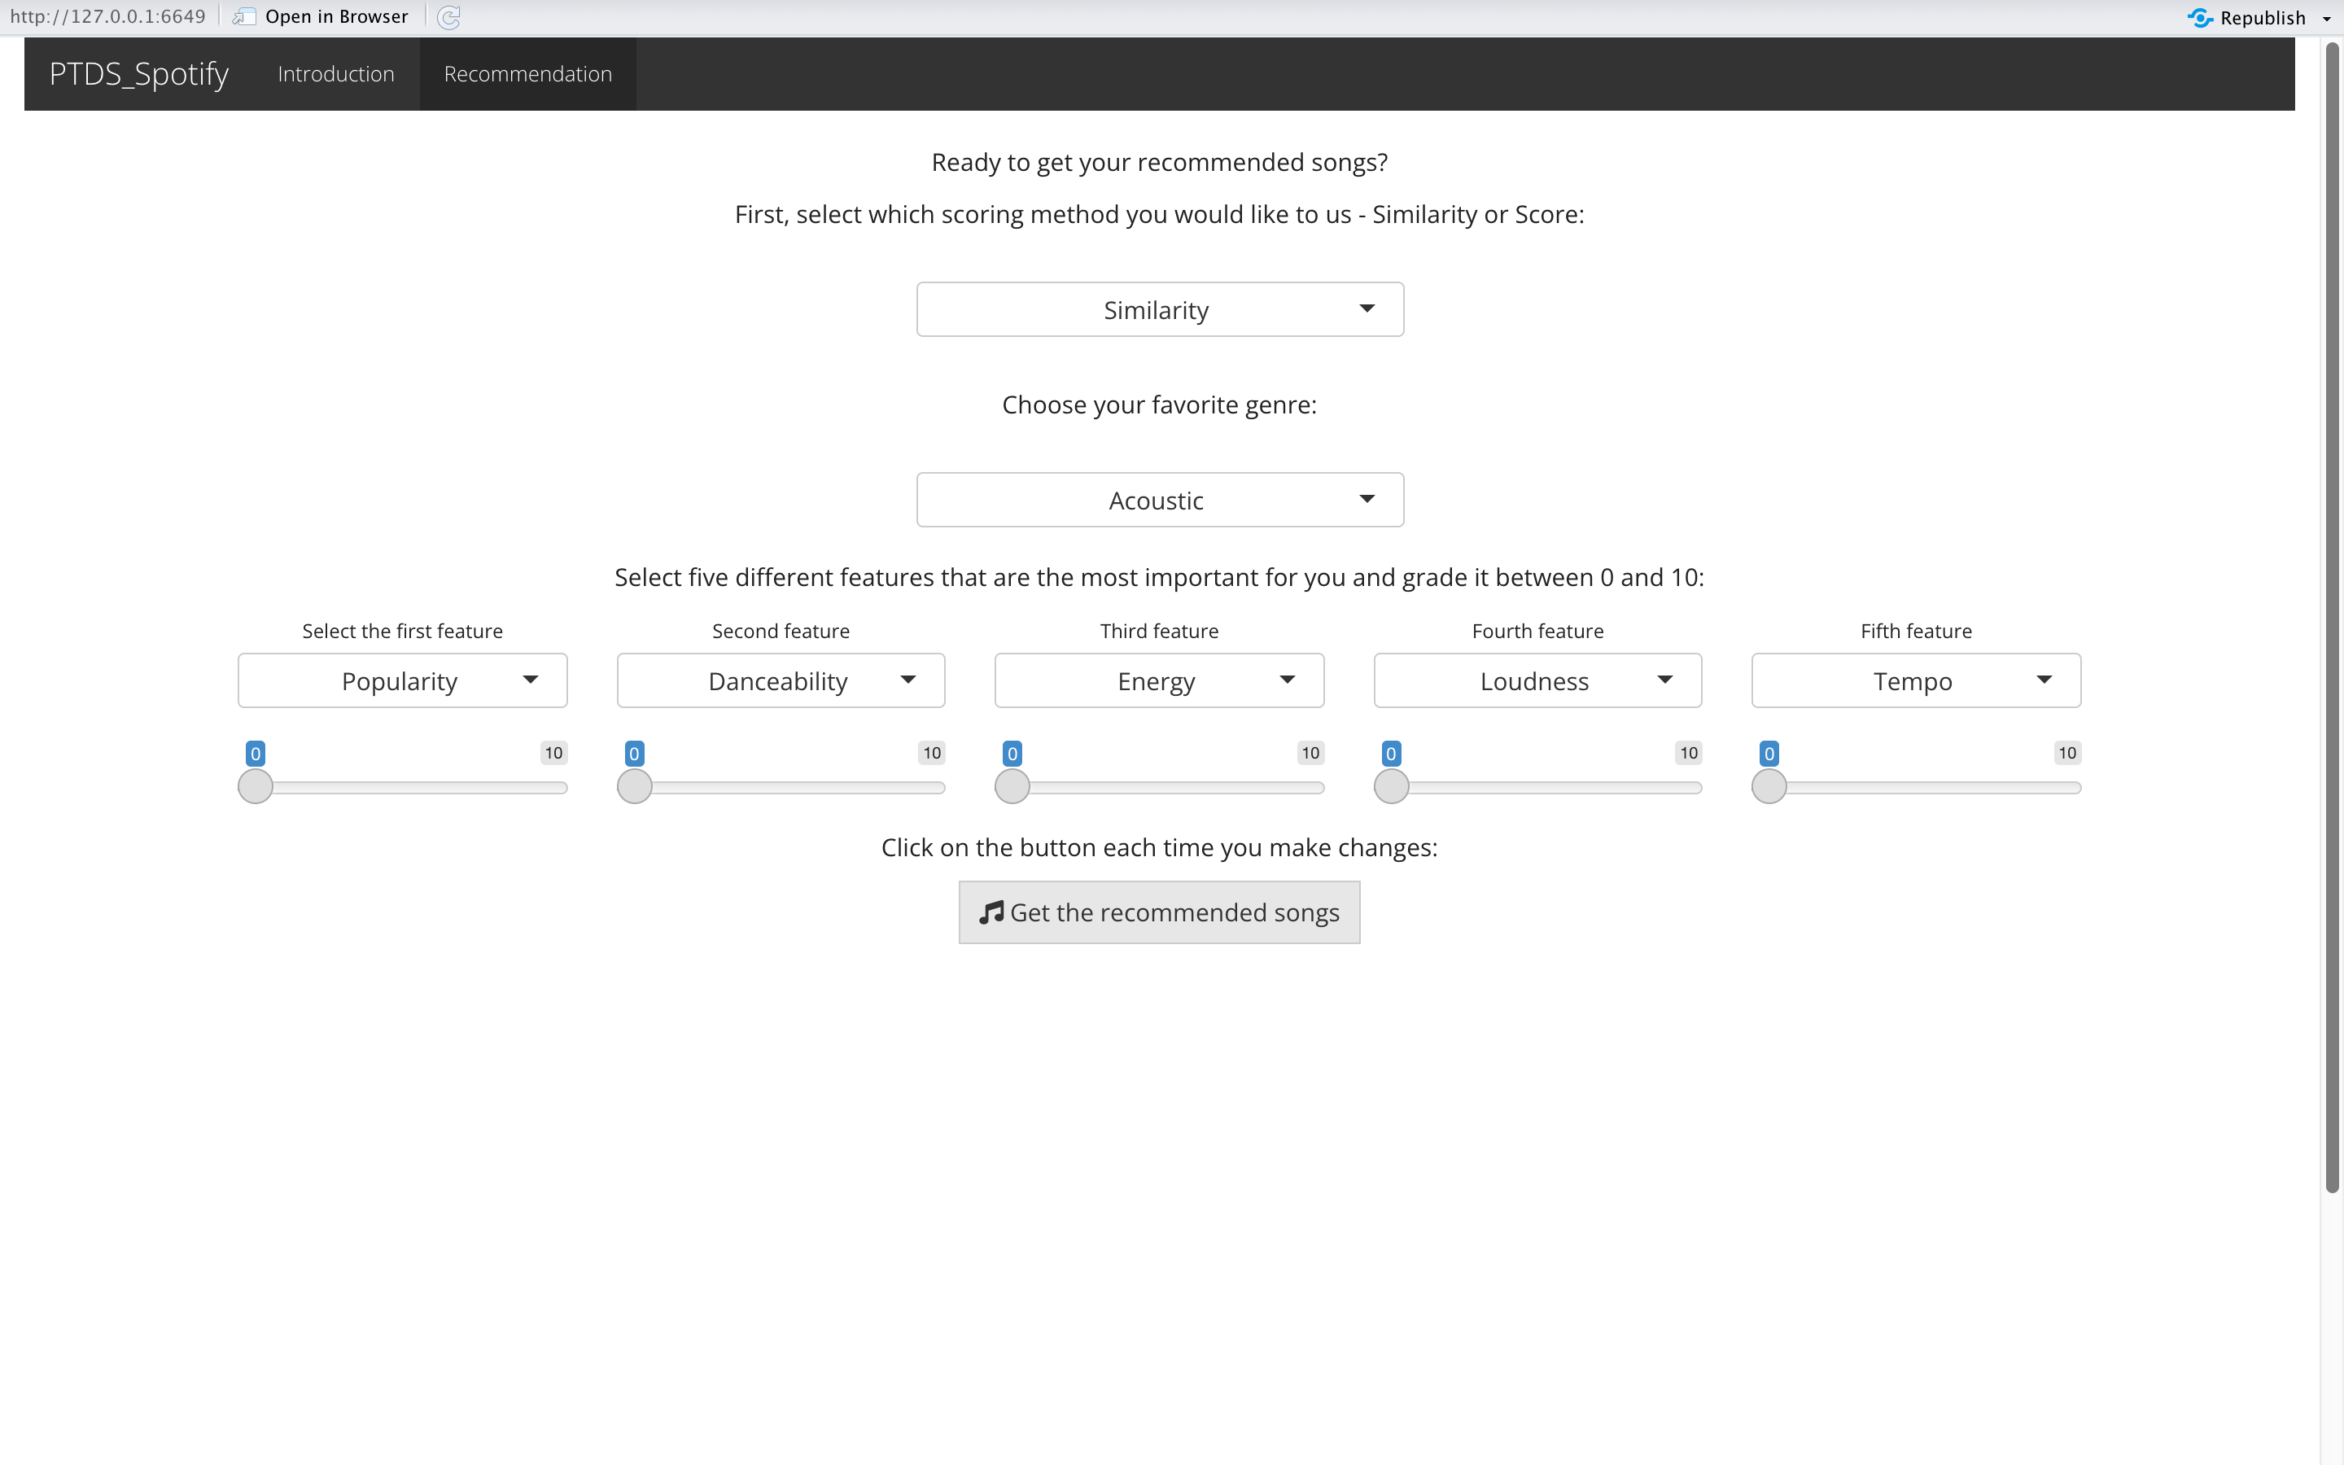
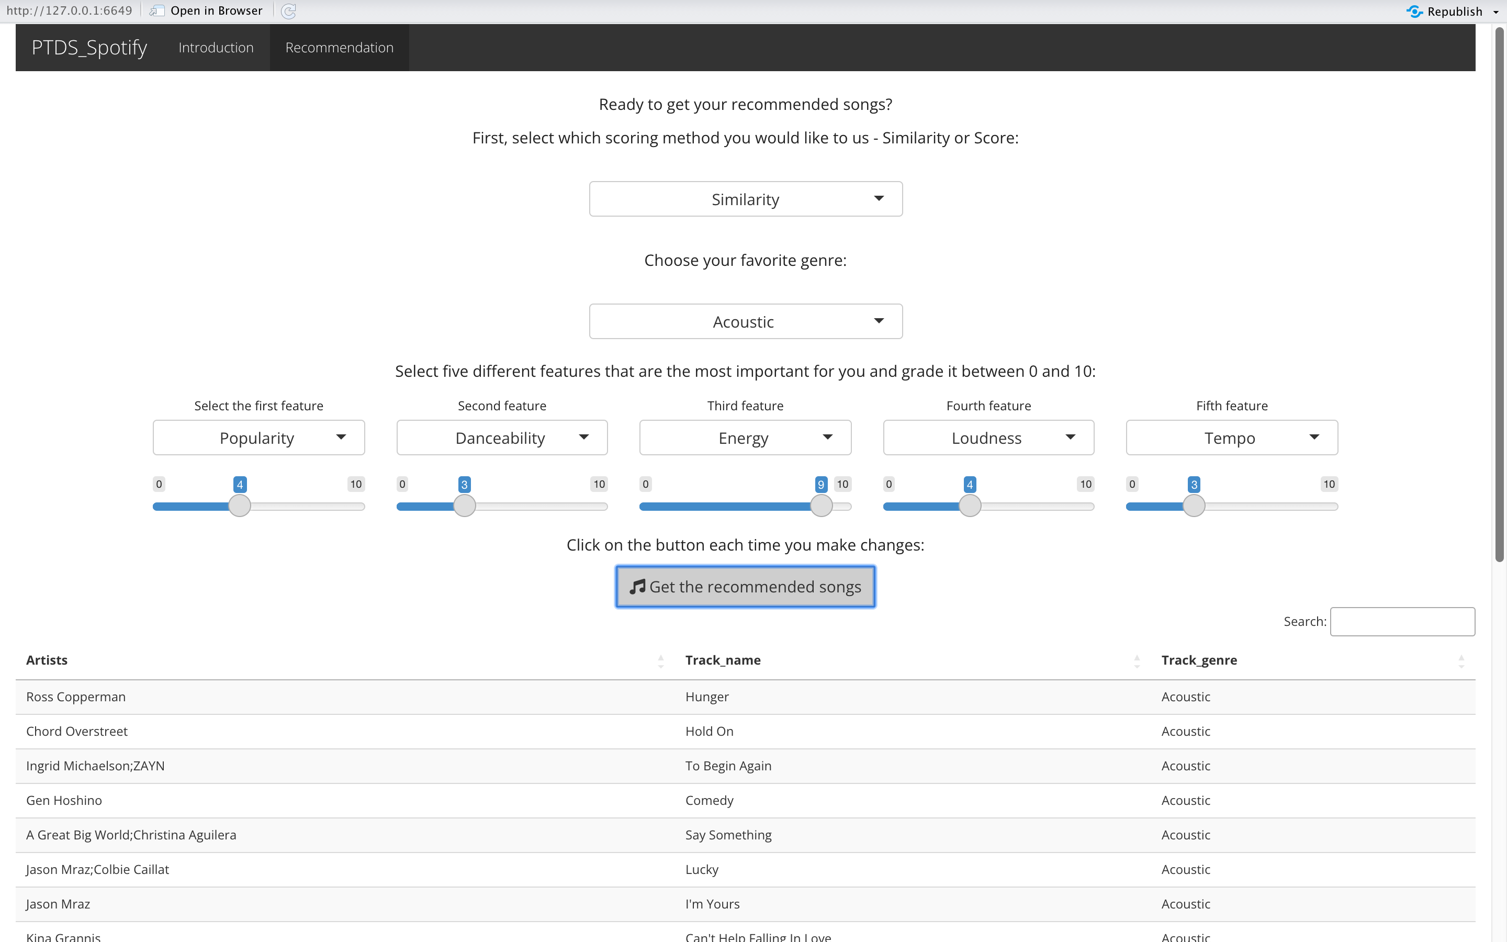
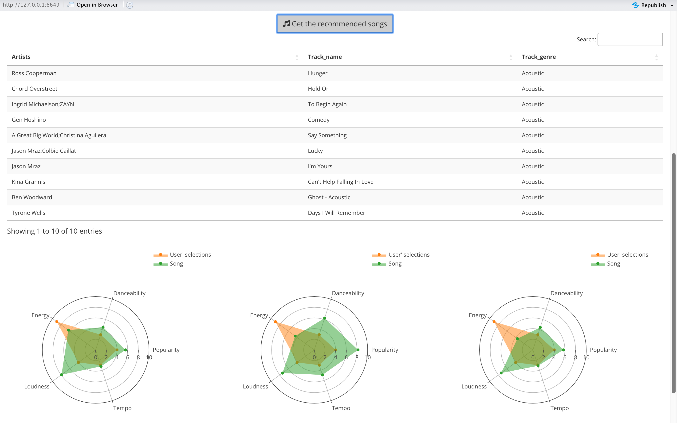
First Page
Introduction

Slide 18
Second Page
Recommendation
Filters
Recommendation list
Radar Plot

Slide 19
Second Page
Recommendation
Recommendation List
Top10

Slide 20

Second Page
Recommendation
Scroll down
Radar plot for top 3

Slide 21

LIMITATION & FUTURE ENHANCEMENT
Data Acquisition
Real-time data update
Algorithm
Users can define the weight of features in the scoring function
User can choose their favorite song directly
Shiny APP
Record each search results
More visualization for the recommendation list

Slide 22

THANKS FOR YOUR ATTENTIONS!

